Slide 1
Mocking Atari for Deep Reinforcement Learning (work in progress)
A. Atrey¹, K. Clary¹, J. Foley²,
D. Jensen¹, E. Tosch¹, S. Witty¹
¹University of Massachusetts Amherst
College of Information and Computer Sciences
Knowledge Discovery Laboratory
Amherst, MA
²Smith College
Department of Computer Science
Northampton, MA

Slide 2
DeepMind: Training Deep RL
DeepMind can learn to play Atari games from images alone.
This was done using deep reinforcement learning.
Tools like the Arcade Learning Environment (ALE) and OpenAI democratize deep learning.

Slide 3
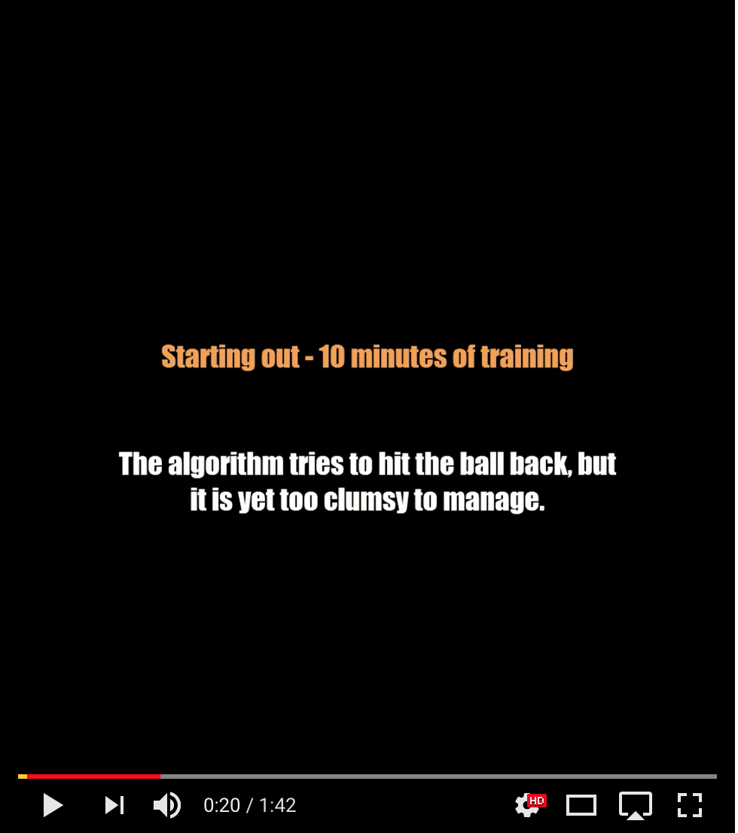
Irresistible to Anthropomorphize

Slide 4
But how can we know the difference?
Is the agent:
Digging tunnels, or
Hashing the current set of pixels to a very large lookup table that maps from pixels to the highest-valued action?
Problem:
We are just passive observers.

Slide 5
Objective: Test Intuitions
We would like a way to formally specify our intuitions.
e.g., Whenever the agent is one brick away from forming a tunnel, it aims the ball at that brick.
Possible tests:
Completes tunnel on next turn
Completes tunnel before dying again
Completes tunnel within t minutes
Maybe good, maybe not?
Right now no easy way to tell.

Slide 6
Solution: Mock Atari Behavior with Toybox
ALE
Toybox

Slide 7
Easily Manipulable Game State
Backend written in Rust
State exported to JSON
Some Rust-supported queries for speed
Python API

Slide 8
Testing with Toybox
Easy?
Hard?

Slide 9
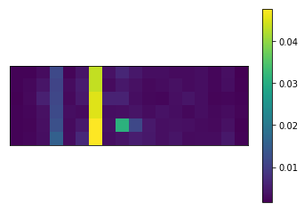
Can query and analyze the data
Try: Run test for 30 trials.
1/avg. score
% survive to hit target brick
Leads to other queries
1/avg. time

Slide 10
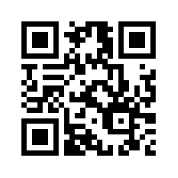
Thanks and Acknowledgements
Thanks to our collaborators at Brown University and Charles River Analytics!
This material is based upon work supported by the United States Air Force under Contract No, FA8750-17-C-0l20.
Any opinions, findings and conclusions or recommendations expressed in this material are those of the author(s) and do not necessarily reflect the views of the United States Air Force.

